Slide 1
Overview of Available Biobased Commercial Materials and Services

Slide 2
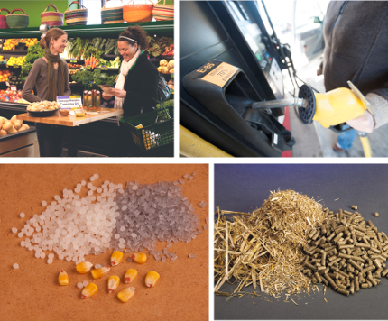
About AURI
AURI helps develop new uses for agricultural commodities
AURI was created by the MN Legislature, and its mission is to foster long-term economic benefit through value-added agricultural products.

Slide 3
AURI Focus Areas
Biobased
Products
Coproducts
Food
Renewable
Energy

Slide 4
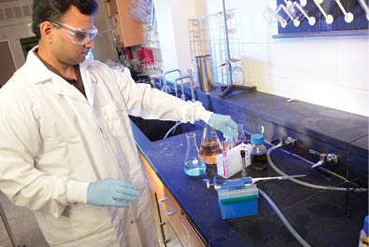
AURI Client Services
Applied Research
Technical Assistance
Commercialization
AURI Connects

Slide 5
AURI Client Services
Research
Through practical, applied research, AURI identifies emerging opportunities to add value to agriculture products.
AURI Connects
With a broad range of networks, AURI supports ongoing, purposeful connection of resources and partners along the value chain.
Commercialization Services
Economic feasibility assessments
Product mix formulation
Counsel on scaling up production size
Product and process development
Product evaluation and testing

Slide 6
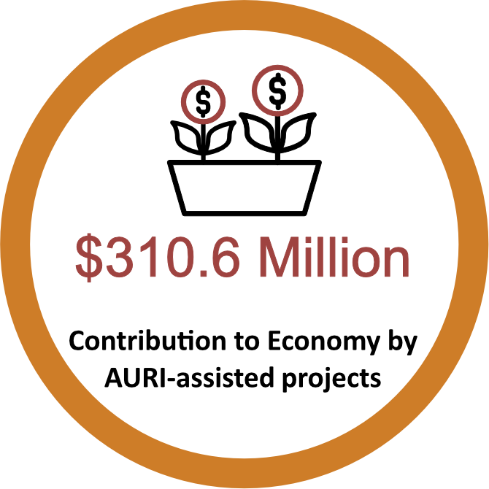
Statewide Economic Impact

Slide 7
AURI Biobased Facilities and Capabilities
Analytical Chemistry Lab
Chromatography
Spectroscopy
Wet chemical analysis
Physical characterization
Biobased Products Lab
Chemical processing of straw, stover and other biomass materials
Extraction and characterization of oils and high-value components from oilseed meal and other feedstocks
Transesterification and esterification reactions for demonstration of biodiesel processing
Small-scale fermentation and digestion processes for production of fuels
Distillation and evaporation for process development
Coproducts Utilization Laboratory
Grinding
Milling
Blending
Pelleting
Drying (mechanical and thermal)
Product characterization
Particle size analysis
Decortication
Oil filtration
Dehulling
Aspiration
Sieve Separation

Slide 8
Examples* of Biobased Solutions
Just Bio Fiber / Hempcrete
Fibonacci, LLC / HempWood
BioComposites Group / Terrafibre
Demilec / HeatLok Soy
RoofMaxx
CORTEC
Renewable Coating Solutions, LLC / BioSealcoat®
BioSpan / RePlay
*Information contained herein regarding the biobased solution examples, the products, trade name, trademark, manufacturer, or otherwise, does not constitute or imply endorsement, recommendation, or favoring by AURI, its directors or employees.

Slide 9
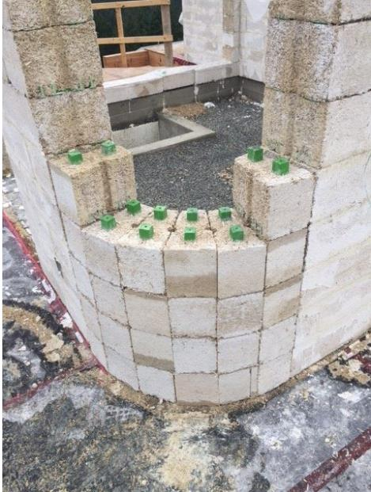
Just Bio Fiber—Hempcrete Blocks
Reinforced Structural building block made from hemp hurd, lime, natural minerals and water
Strong vertical load bearing strength
Highly fire resistant – 2 hr rating
High R-value
Sequesters carbon throughout life cycle
Contributes to LEED and/or WELL credits
Naturally regulates internal temperature and humidity (very breathable) while retaining heat due to high thermal mass
Performed a variety of product tests to meet building codes
*Information contained herein regarding the biobased solution examples, the products, trade name, trademark, manufacturer, or otherwise, does not constitute or imply endorsement, recommendation, or favoring by AURI, its directors or employees.

Slide 10
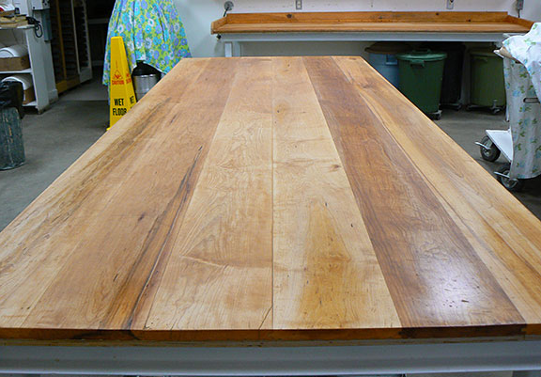
HempWood
Fibonacci cuts ribbons in $5.8M HempWood manufacturing plant in Calloway County
Hemp hardwoods, bioplastics expand crop use beyond CBD
HempWood is the most eco-friendly lumber product on the planet
*Information contained herein regarding the biobased solution examples, the products, trade name, trademark, manufacturer, or otherwise, does not constitute or imply endorsement, recommendation, or favoring by AURI, its directors or employees.

Slide 11
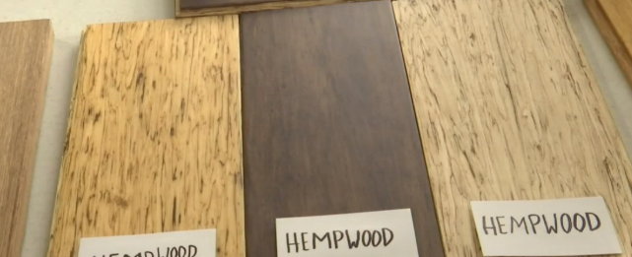
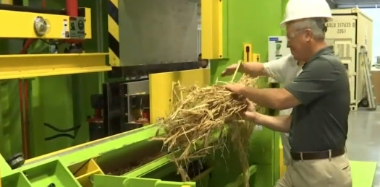
HempWood

Slide 12
HempWood
*Information contained herein regarding the biobased solution examples, the products, trade name, trademark, manufacturer, or otherwise, does not constitute or imply endorsement, recommendation, or favoring by AURI, its directors or employees.

Slide 13
HempWood
Product Specs:
Uses:
Density: 60 lbs/ft 3
Hardness: 2,600 Janka
Stability: 20% Greater than Solid Oak
MC: 10-14%
No Added Formaldehyde
Flooring
Furniture
Counter Tops
Wood Walls
Picture Frames

Slide 14
Terrafibre—Erosion Control Blanket

Slide 15
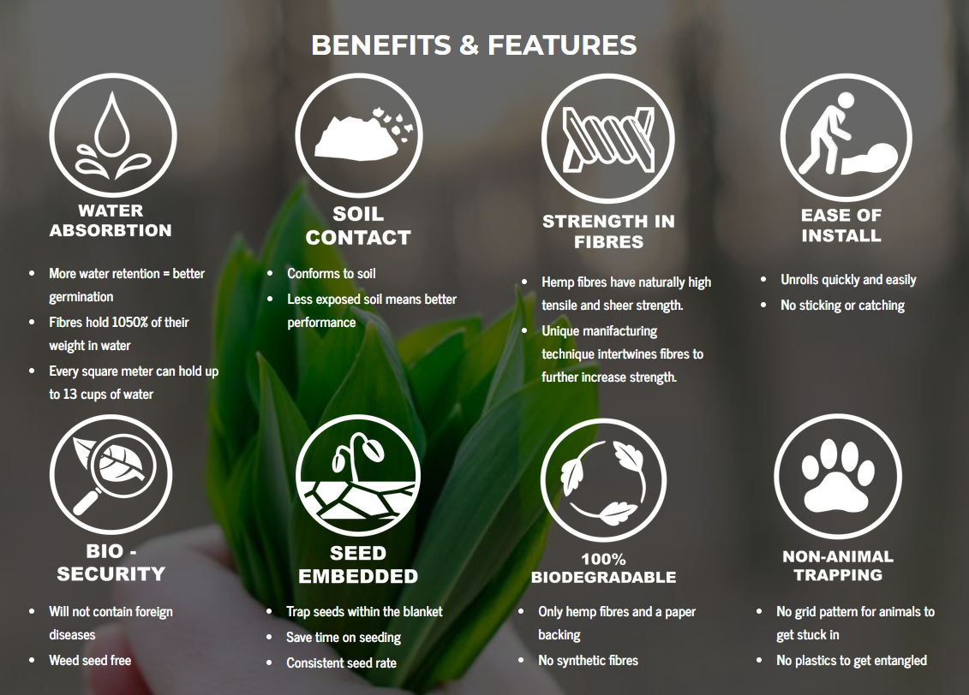
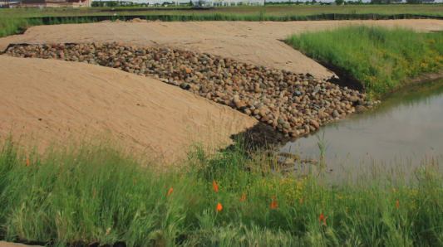
Terrafibre—Erosion Control Blanket
*Information contained herein regarding the biobased solution examples, the products, trade name, trademark, manufacturer, or otherwise, does not constitute or imply endorsement, recommendation, or favoring by AURI, its directors or employees.

Slide 16
HEATLOK SOY—Soy-Based Foam Insulation
*Information contained herein regarding the biobased solution examples, the products, trade name, trademark, manufacturer, or otherwise, does not constitute or imply endorsement, recommendation, or favoring by AURI, its directors or employees.

Slide 17
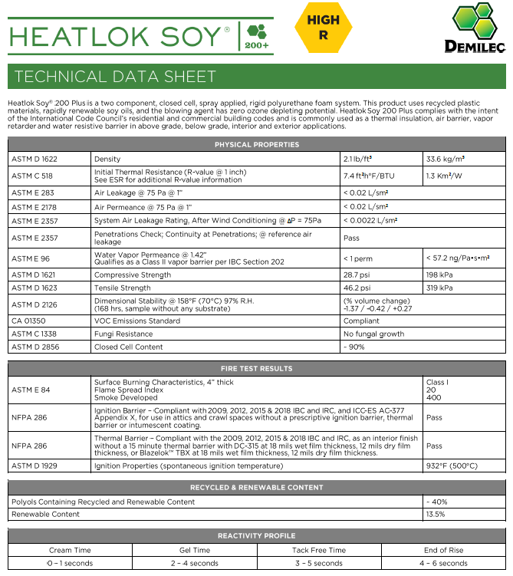
HEATLOK SOY—Soy-Based Foam Insulation
*Information contained herein regarding the biobased solution examples, the products, trade name, trademark, manufacturer, or otherwise, does not constitute or imply endorsement, recommendation, or favoring by AURI, its directors or employees.

Slide 18
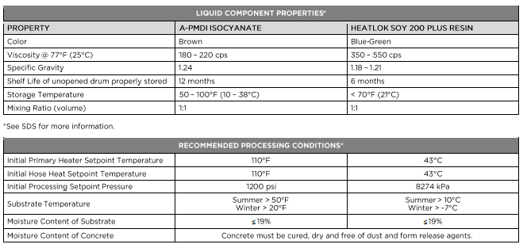
HEATLOK SOY—Soy-Based Foam Insulation
*Information contained herein regarding the biobased solution examples, the products, trade name, trademark, manufacturer, or otherwise, does not constitute or imply endorsement, recommendation, or favoring by AURI, its directors or employees.

Slide 19
HEATLOK SOY—Soy-Based Foam Insulation
*Information contained herein regarding the biobased solution examples, the products, trade name, trademark, manufacturer, or otherwise, does not constitute or imply endorsement, recommendation, or favoring by AURI, its directors or employees.

Slide 20
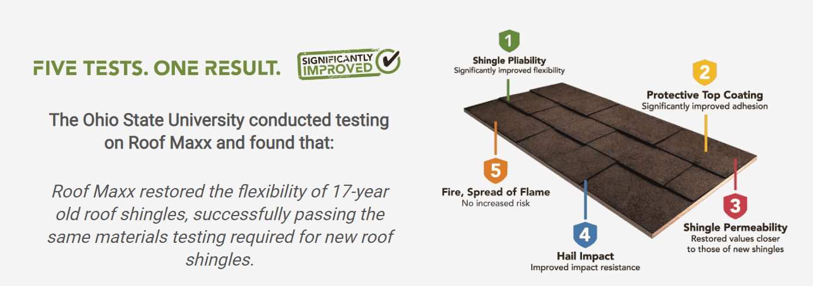
ROOF MAXX

Slide 21
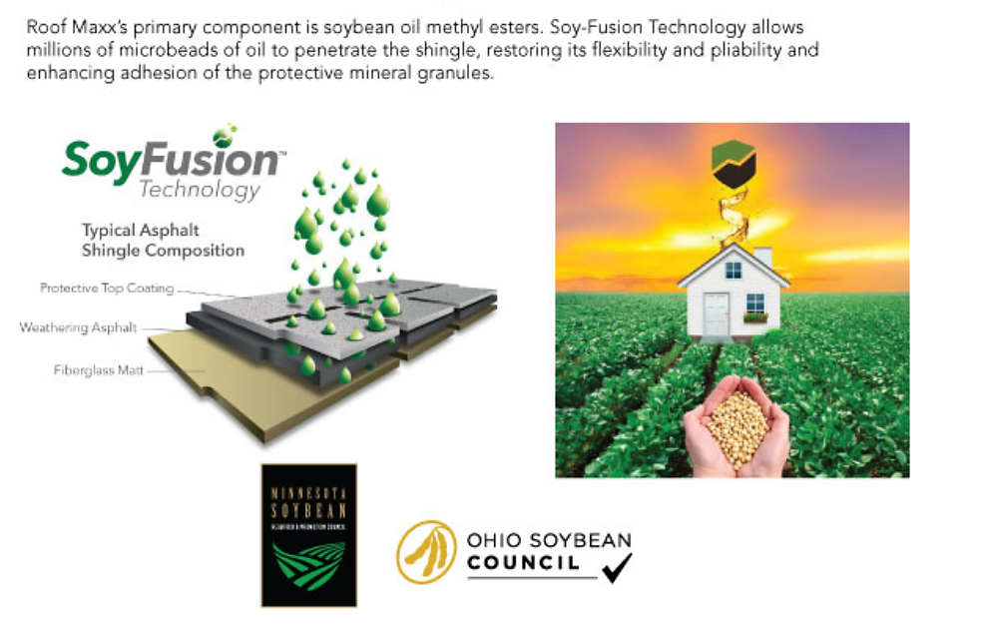
ROOF MAXX

Slide 22
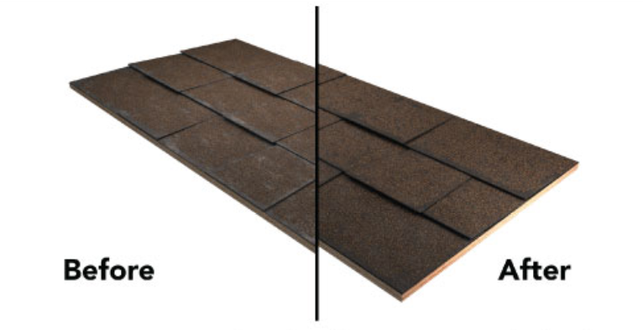
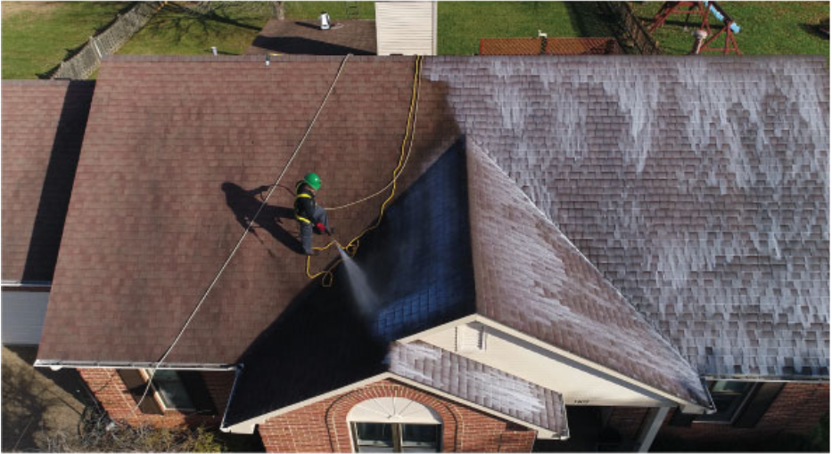
ROOF MAXX
*Information contained herein regarding the biobased solution examples, the products, trade name, trademark, manufacturer, or otherwise, does not constitute or imply endorsement, recommendation, or favoring by AURI, its directors or employees.

Slide 23
CORTEC
*Information contained herein regarding the biobased solution examples, the products, trade name, trademark, manufacturer, or otherwise, does not constitute or imply endorsement, recommendation, or favoring by AURI, its directors or employees.

Slide 24
CORTEC

Slide 25
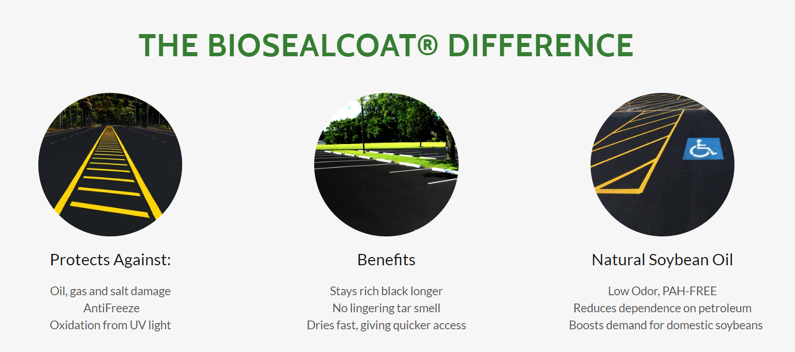
RCS
*Information contained herein regarding the biobased solution examples, the products, trade name, trademark, manufacturer, or otherwise, does not constitute or imply endorsement, recommendation, or favoring by AURI, its directors or employees.

Slide 26
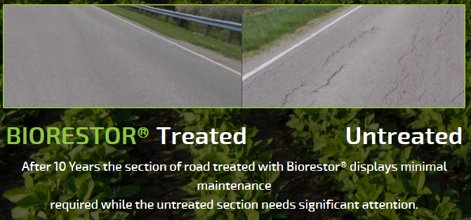
BIOBASED SPRAY SYSTEMS LLC
*Information contained herein regarding the biobased solution examples, the products, trade name, trademark, manufacturer, or otherwise, does not constitute or imply endorsement, recommendation, or favoring by AURI, its directors or employees.

Slide 27
BioSpan Technologies
*Information contained herein regarding the biobased solution examples, the products, trade name, trademark, manufacturer, or otherwise, does not constitute or imply endorsement, recommendation, or favoring by AURI, its directors or employees.

Slide 28
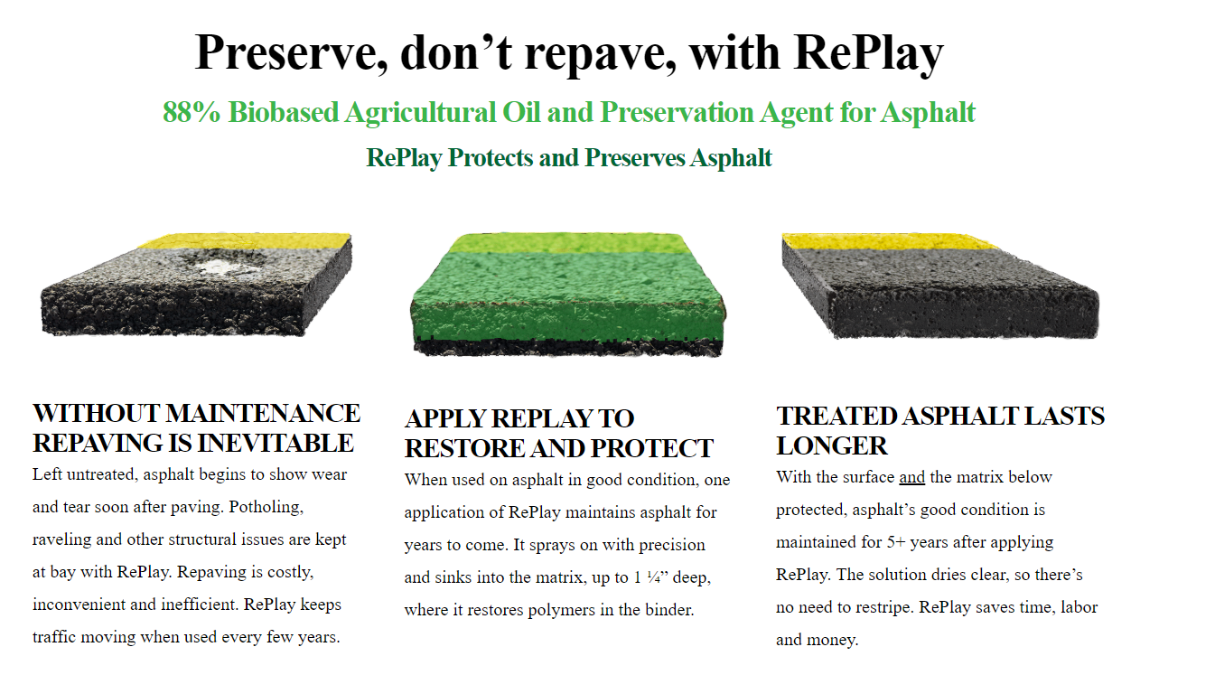
BioSpan Technologies
*Information contained herein regarding the biobased solution examples, the products, trade name, trademark, manufacturer, or otherwise, does not constitute or imply endorsement, recommendation, or favoring by AURI, its directors or employees.

Slide 29
BioSpan Technologies
This map will be updated annually.

Slide 30
BioSpan Technologies - RePlay

Slide 31
Where to Buy Biobased Products*
For information on Biobased Materials Manufacturers, please visit AURI’s website at AURI.org.
*Information contained herein regarding the biobased solution examples, the products, trade name, trademark, manufacturer, or otherwise, does not constitute or imply endorsement, recommendation, or favoring by AURI, its directors or employees.

Slide 32
Questions
Visit us online at: auri.org
Call: 800.279.5010
Email: hstanislawski@auri.org or jgosse@auri.org

