Slide 1


Slide 2
Notes:
About Us Briefly:
And this is lots D, E and F along with our new harvest and processing plant in Foley, MN.
We’ve been doing this for what feels like a long time, but compared to most people in the game is actually quite short. Entering our 5th season, we’re one of the youngest farms of our scale by anywhere from 15 to 300 years. A big part of my job has been ‘getting caught up’ and doing my best to learn from the folks that have been doing this for a long time. And I’m here to share that with you! So I present:

Slide 3
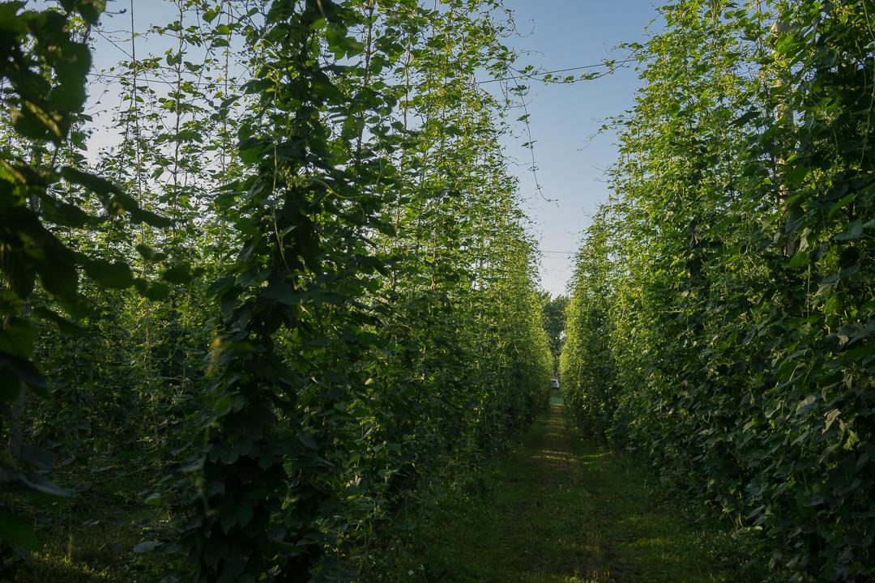
Notes:
This is some Cascade that we planted the first time we said to eachother “let’s get serious about growing hops”

Slide 4
Notes:
And this is lots D, E and F along with our new harvest and processing plant in Foley, MN.
We’ve been doing this for what feels like a long time, but compared to most people in the game is actually quite short. Entering our 5th season, we’re one of the youngest farms of our scale by anywhere from 15 to 300 years. A big part of my job has been ‘getting caught up’ and doing my best to learn from the folks that have been doing this for a long time. And I’m here to share that with you! So I present:

Slide 5
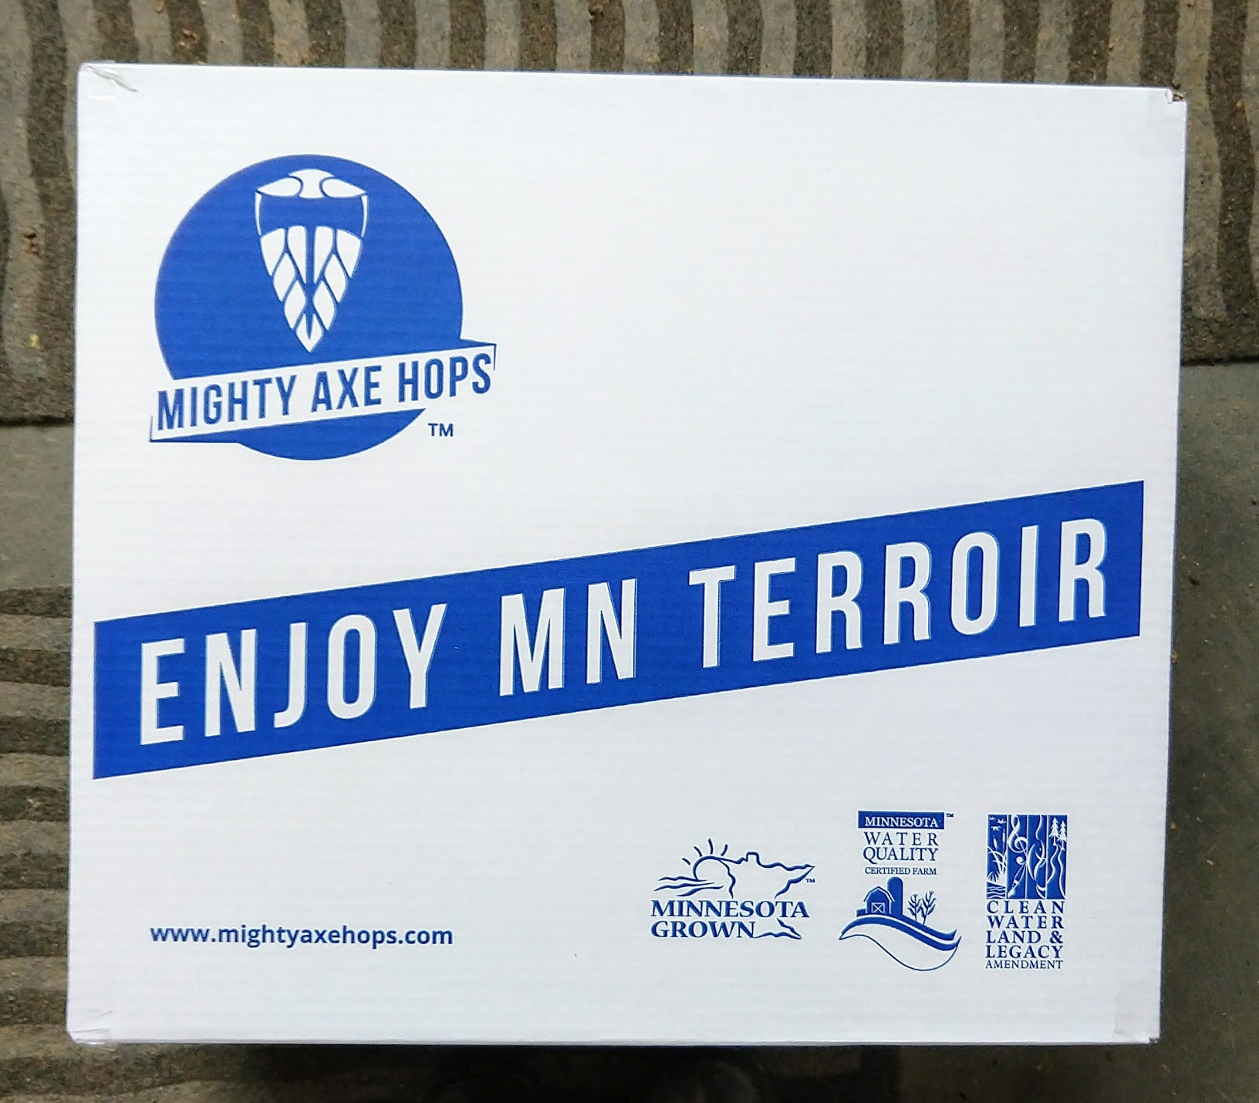
Notes:
This is some Cascade that we planted the first time we said to eachother “let’s get serious about growing hops”

