Slide 1
Healthy Oilseeds, LLC
Carrington, North Dakota

Slide 2
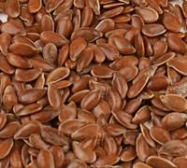
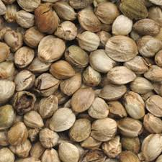
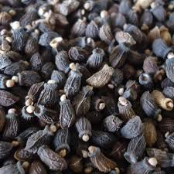
Healthy Oilseeds
Specialty oilseed processing
Flaxseed, hempseed and borage
Roasting, cold press expelling, milling or size reduction and sifting
75% export and 25% domestic sales

Slide 3
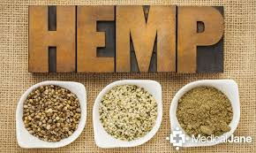
Hemp and our products!
oils, high in omega 3, take a spoonful per day!
protein powders, including all the amino acids, great for vegetarians!
roasted seeds, great as a salad topper!

Slide 4
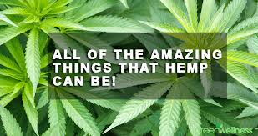
How our customers use our hempseed products!
Salad dressings
Pasta
Baking ingredients (brownie mix, pancake mix, etc.)
Salad toppers
Snacks
Energy bars
Granola
Protein smoothies
Topical skin and joint treatment (lotions, balms, soap, hair products)
Pet supplements

Slide 5
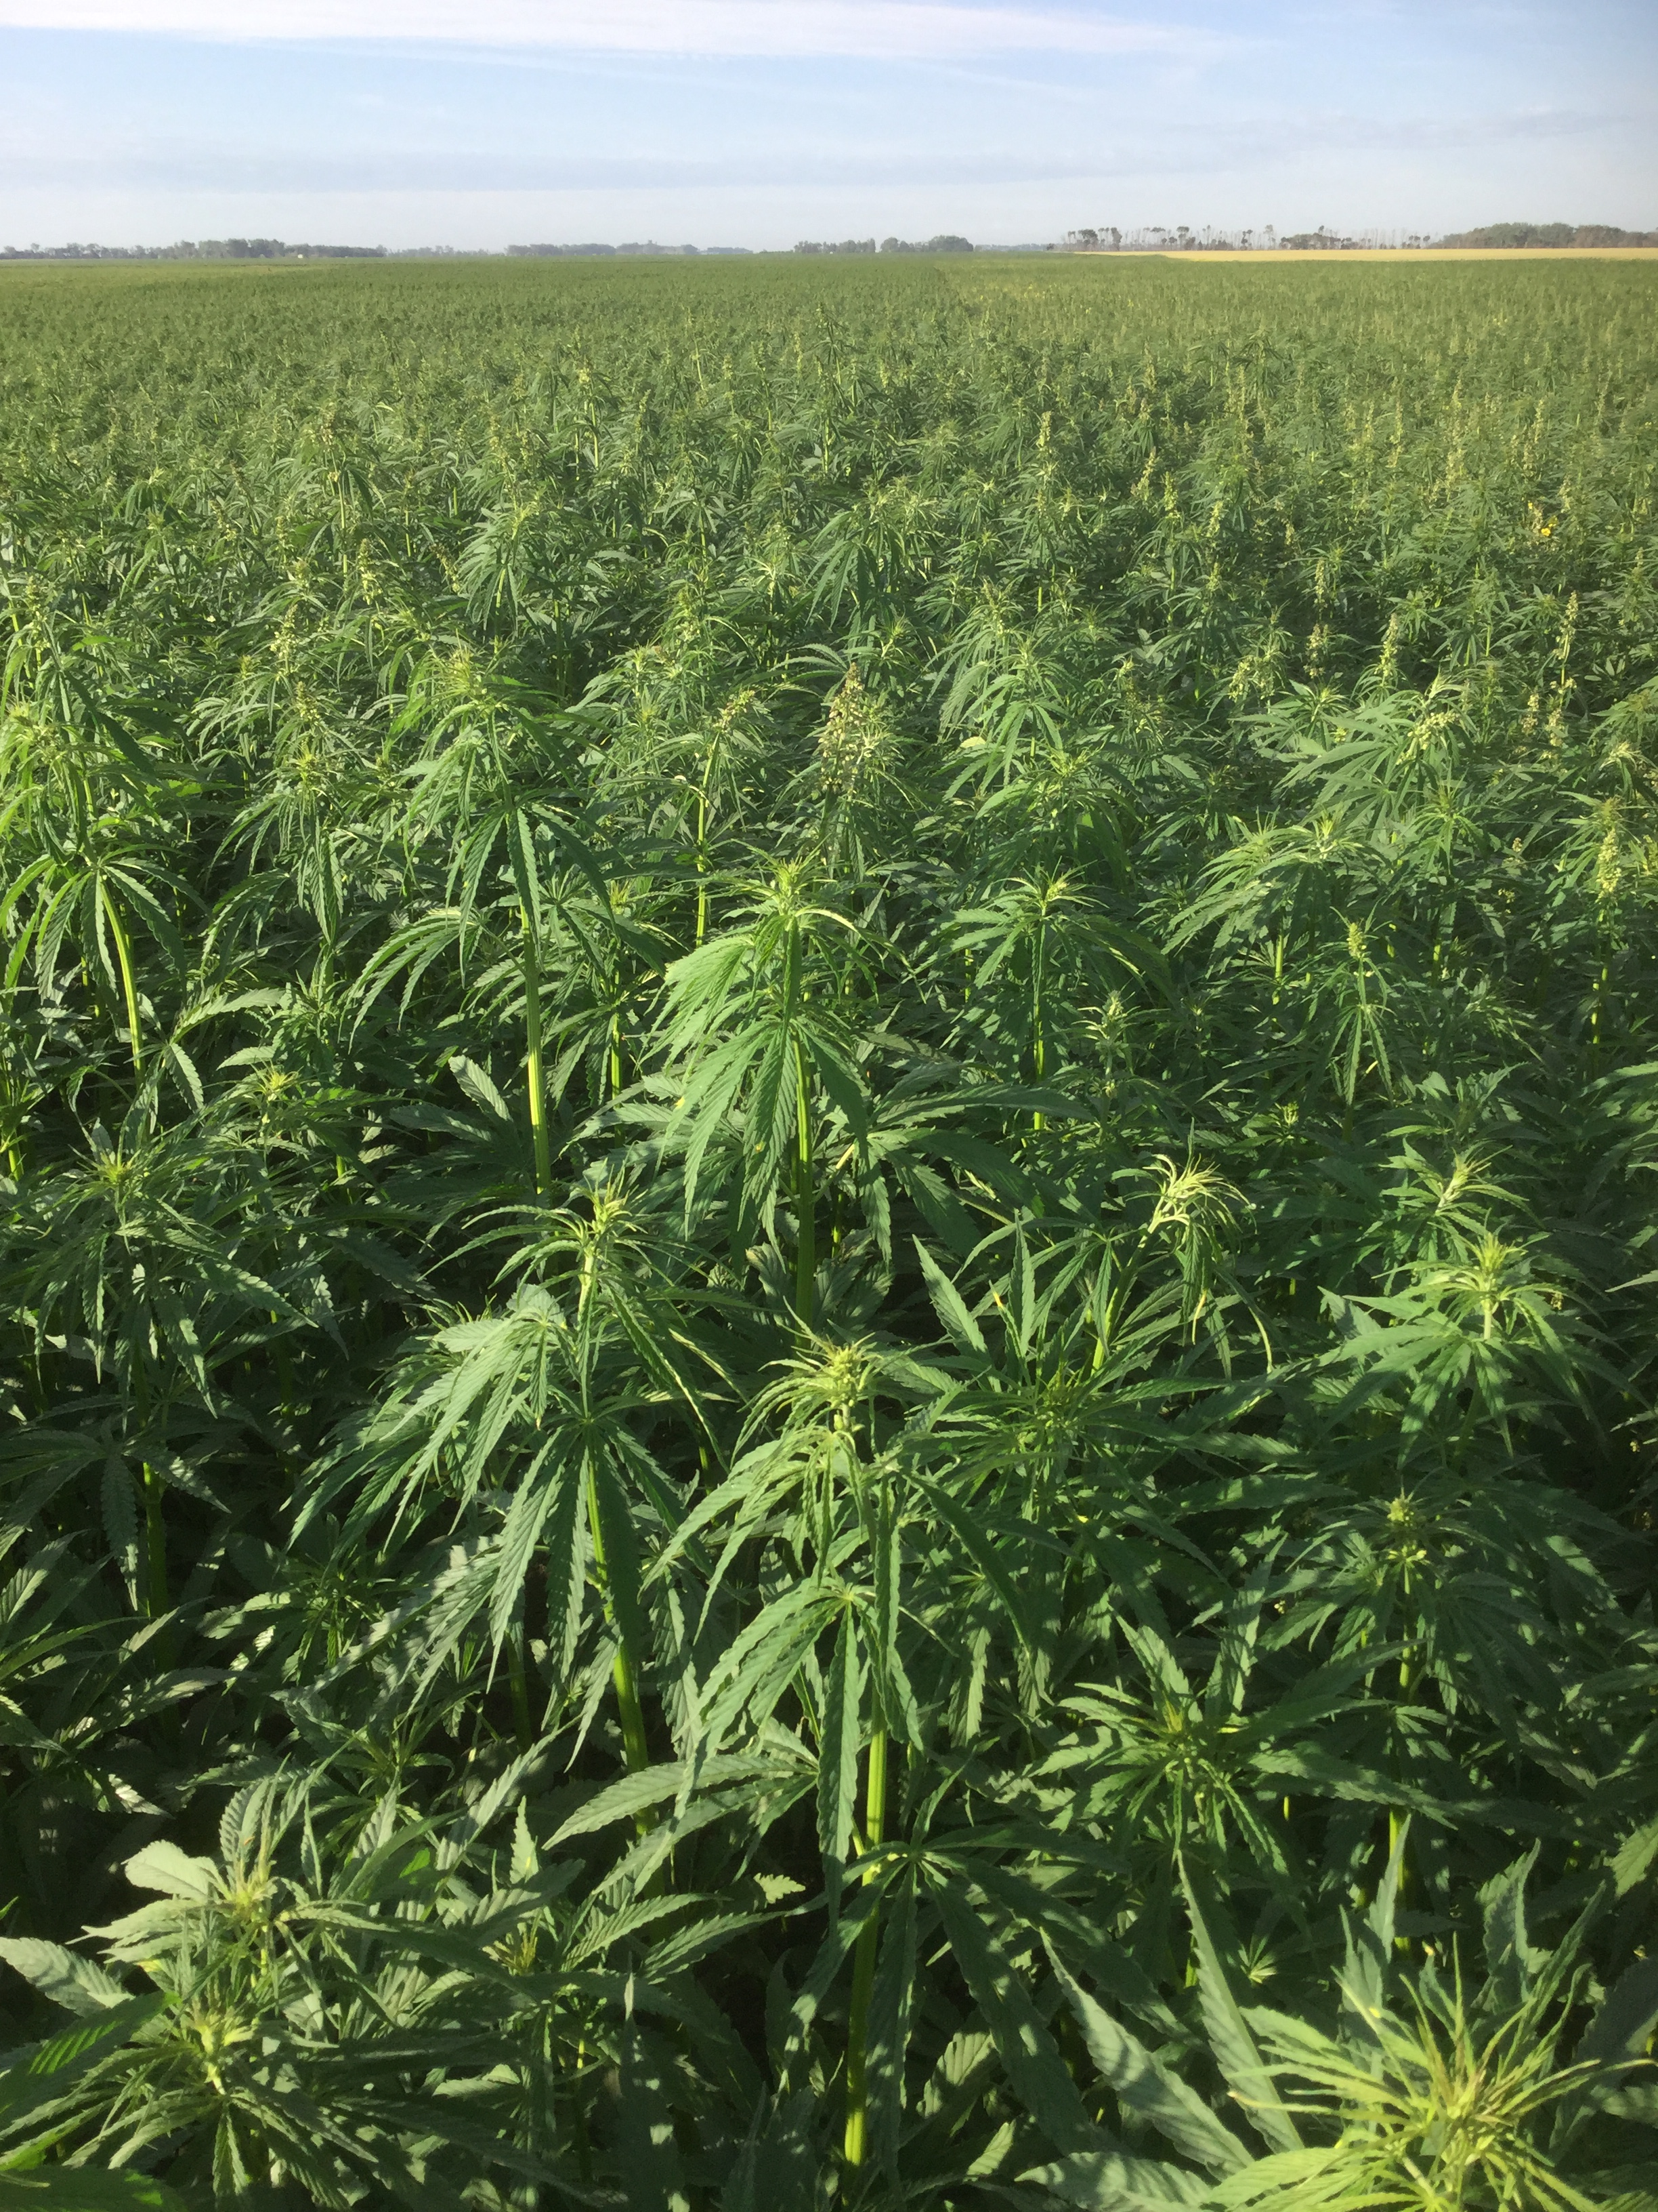
Growing hemp in America Not all is organic (3 year transition) Pesticide free

Slide 6
Hempseed
PROS:
Great for vegetarians
Complete meat replacement
Great source of omega 3 essential fatty acids
Good source of fiber
CONS:
Need to develop markets
Federal government considers hemp a narcotic

