Slide 1
FastTRAC
Training for a Better Workforce in Southwest Minnesota

Slide 2
Today’s Workforce and Economy
Skills are at the center of the new economy.
New technologies evolving everyday.
More and more employers cannot find the skilled workers to grow their business.
Number of jobs is greater than the number of skilled workers.
Issue will continue to grow if the gap is not addressed.
Close the growing skills gap through programs tailored to working learners

Slide 3
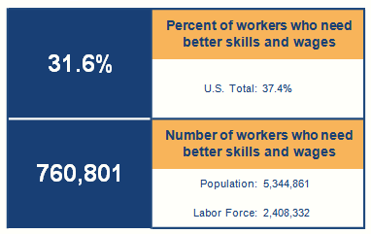
Building the Middle Class with Better Skills and Wages
Who Would be Helped by Stronger Pathways?
Worked at least some of the last year but earned poverty-level wages
= 283,444
Worked at least some of the last year and earned above poverty-level wages but below the state median wage
= 425,955
Are seeking work but have not worked in the last year
= 51,402
Target Population = 760,801
Source: COWS calculations from 2011 American Community Survey data provided by the U.S. Census Bureau. Note that this data set does not include information on certificate-holders. For detailed information on the sources and methodology, see http://www.clasp.org/admin/site/documents/files/BSW_Sources.pdf

Slide 4
Regional Characteristics
22 Counties - 25% of the State Population
Two Regional Centers
Marshall Population 13,000
Worthington Population 12,000
Demographics
Increasing immigrant population
Baby boomers exiting the workforce
Primary Industry Sectors
Agriculture Healthcare
Manufacturing Energy
Transportation Finance / Banking
Government
Target Population (31.6%)
22 Counties
= 23,530
Marshall and Worthington
= 3,600
Notes:
State Population: 5,344,861
Labor Force: 2,408,332 (45%)
Pathways: 760,801 (31.6%)
22 Counties: 163,410
Labor Force: 73,535 (45%)
Pathways: 23,530 (32%)
Marshall and Worthington: 25,000
Labor Force: 11,250
Pathways: 3,600

Slide 5
Training for a Better Workforce
Make available opportunities for unemployed, under-employed, and underprepared workers to succeed.
Provide local employers with the skilled workers they need to grow their business.
This can be accomplished through FastTRAC training programs.

Slide 6
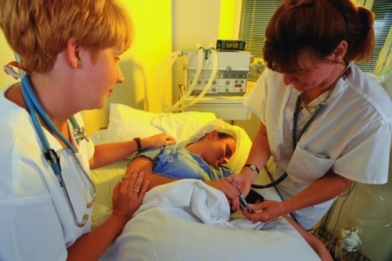
FastTRAC – SW MN Pathway Training
Prepare adults for and enter a career pathway that leads to long-term, stable employment.
Integrating basic skills education and career-specific training.
Targeting high-demand occupations.
Meeting the needs of working learners.
Helps workers with academic gaps
Move into the educational arena.
Develop study skills.
Increase their academic potential.
Areas of focus / Workforce needs
Healthcare
Universal Healthcare Worker
Manufacturing
Machine Maintenance Technician
Metal Fabricator/Welder
GreenPOWER training.

Slide 7
Summary of FastTRAC Program Success:
Industrial Maintenance training
60% of participants completed and entered employment*
Average wage $12.26/hr
Welding training
71% of participants completed and entered employment*
Average wage $15.56/hr
Universal Healthcare Worker training
72% of participants completed and entered employment*
Average wage $11.74/hr
*Statistics reflect the number of participants who entered employment in their field of training. Other participants may have found employment in another field.

Slide 8
FastTRAC Partner Organizations:
Southwest Regional Adult Basic Education
Southwest Minnesota Workforce Center
Locations
Jackson/Fairmont
Marshall
Montevideo
Worthington
Locations
Jackson
Marshall
Montevideo
Worthington
Minnesota West Community & Technical College
5 Campus Locations
4 Educational Sites
Over 70 Degree Programs
2 Year Programs
Partners with SMSU 4 Year Programs

Slide 9
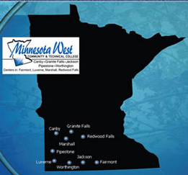
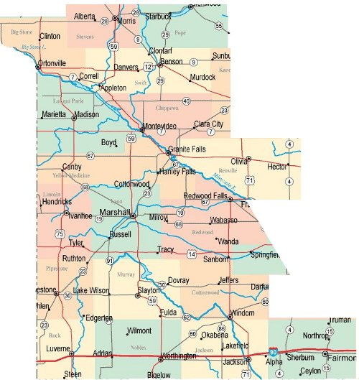
Southwest Minnesota WorkForce Centers
Southwest Minnesota Adult Basic Education
Montevideo
Marshall
Worthington

Slide 10
FastTRAC Funding in SW Minnesota:
GRANT ALLOCATION GRANT PERIOD
WIA 10% $218,700 12/1/03 – 12/1/05
(BRIDGING THE HEALTHCARE CAREER ACADEMIES GAP)
MCKNIGHT FOUNDATION $200,000 3/22/04 – 12/31/06
(HEATLH CAREERS PREPATORY ACADEMY PROJECT)
OTTO BREMER $78,000 7/1/03 – 6/30/05
(PIC/ABE PLACEMENT GRANT)
OTTO BREMER $40,000 4/1/06 – 5/31/08
(HEALTHCARE CAREER PREPATORY ACADEMIES)
MINNESOTA JOB SKILL PARTNERSHIP $156,288 6/27/06 – 6/30/08
(LOW-INCOME WORKER WELDING TRAINING)
WIA MN SECTOR PARTNERSHIP GRANT $50,000 7/1/07 - 6/15/08

Slide 11
FastTRAC Funding in SW Minnesota:
GRANT ALLOCATION GRANT PERIOD
H1B HEALTHCARE GRANT (80 COUNTIES) $3,000,000 3/15/02 - 6/15/2005
MINNESOTA JOB SKILL PARTNERSHIP $176,176 6/17/08 - 10/31/10
(WELDING/Industrial Maintenance)
WIA FASTRAC ARRA $61,500 6/22/09 – 6/30/10
WIA FASTRAC ARRA #1 $40,347 12/15/09 – 3/31/11
(PROGRAM DESIGN)
WIA FASTRAC ARRA #2 $25,000 12/15/09 – 3/31/11
(PROGRAM DESIGN)
FASTRAC INDUSTRIAL MAINTENANCE $62,267 9/22/10 – 5/31/12
MN STATE ENERGY SECTOR PROJECT $11,700 7/12/10 – 9/24/10
MN STATE ENERGY SECTOR PROJECT $89,850 9/1/10 – 12/31/11
MN STATE ENERGY SECTOR PROJECT $145,000 12/20/10 – 1/31/13

Slide 12
GRANT ALLOCATION GRANT PERIOD
WIA FastTRAC Industrial Maintenance $42,500 9/22/10- 5/31/12
WIA ADULT CAREER PATHWAY $43,384 8/1/11 – 3/31/13
MN STATE ENERGY SECTOR GRANT $100,000 1/1/11 – 9/30/12
(INDUSTRIAL MAINTENANCE)
WIA FASTRAC #1 – HEALTHCARE $18,750 8/1/11 – 5/31/12
WIA FASTRAC #2 – HEALTHCARE $32,766 8/1/11 – 12/31/12
WORKFORCE DEVELOPMENT FUNDS $300,000 7/1/12 – 6/30/13
(ADULT WORKFORCE DEVELOPMENT GRANT
INDUSTRIAL MAINTENANCE/WELDING/HEALTHCARE
MN FASTRAC CAREER PATHWAY $79,141 7/1/12 – 3/31/14
(UNIVERSAL HEALTHCARE)
MN JOB SKILLS PARTNERSHIP $99,968 10/1/12 – 10/31/14
LOW INCOME WORKER GRANT
(WELDING/METAL FABRICATION/MACHINE TOOL)
FASTTRAC HEALTHCARE $112,557 10/1/13 – 6/30/15
MN ADULT WORKFORCE DEVELOPMENT $359,816 10/1/13 – 6/30/15
COMPETITIVE GRANT

Slide 13
More on what Adult Basic Education (ABE) has to offer…
transitions
Educational opportunities to acquire and improve skills.
GED — General Educational Development Diploma
Adult Diploma
ESL — English as a Second Language
EL Civics
Basic Skills Enhancement
Citizenship / Civics Education
Distance and Online Learning
http://mnabe.org/programs
transitions
transitions
transitions
transitions

Slide 14
Considerations to meet your Workforce needs -
31.6% of our workforce need better skills and wages.
This is a significant pool of resources that could help local employers find skilled workers to grow their business.
The sooner Industries recognize this as part of their answer to fill workforce needs, we will have the ability to attract higher skilled individuals in this population.
Be part of the solution. Collaborate with us.
Too often business and educational entities operate in a vacuum.
Partner with FastTRAC to help design our training programs to ensure participants have the right skills to be hired!

Slide 15
Questions or Comments Contact:
Pat Thomas, SW ABE- Marshall Region
pthomas@starpoint.net or
(507) 537-7046

